Slide 1

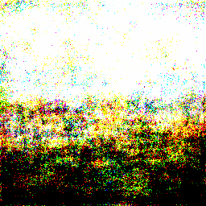
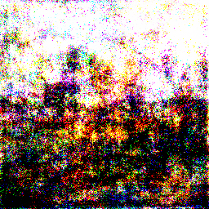
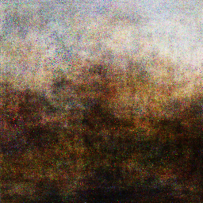
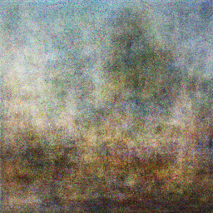
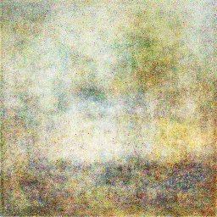
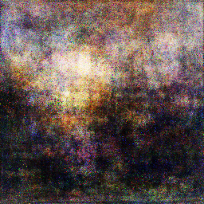
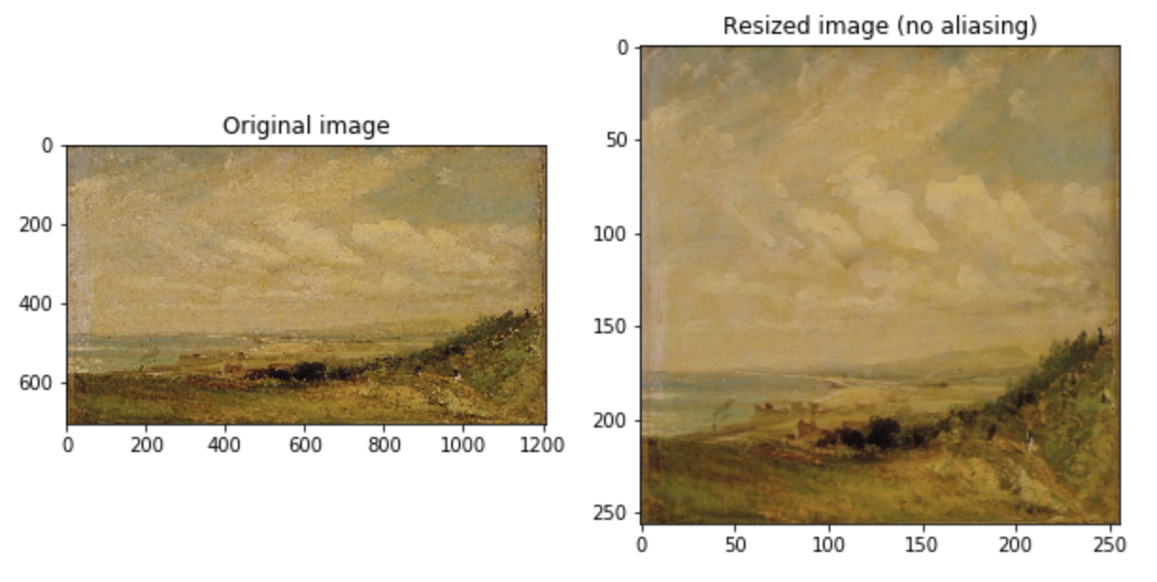
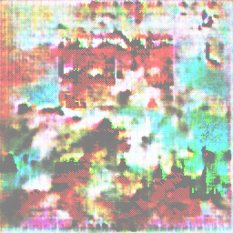
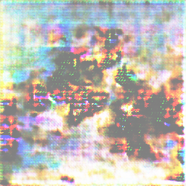
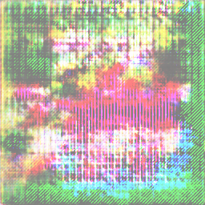
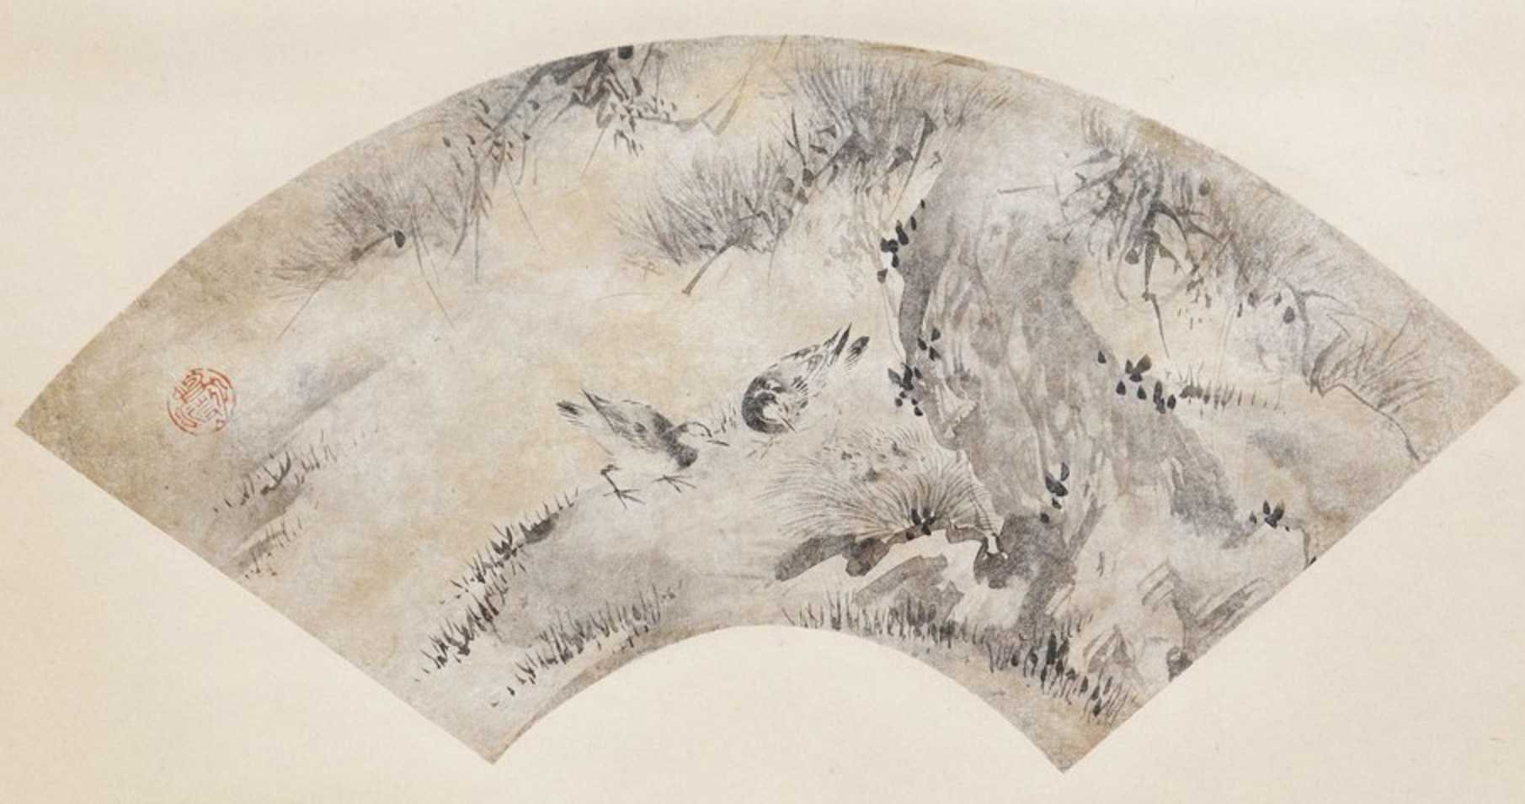
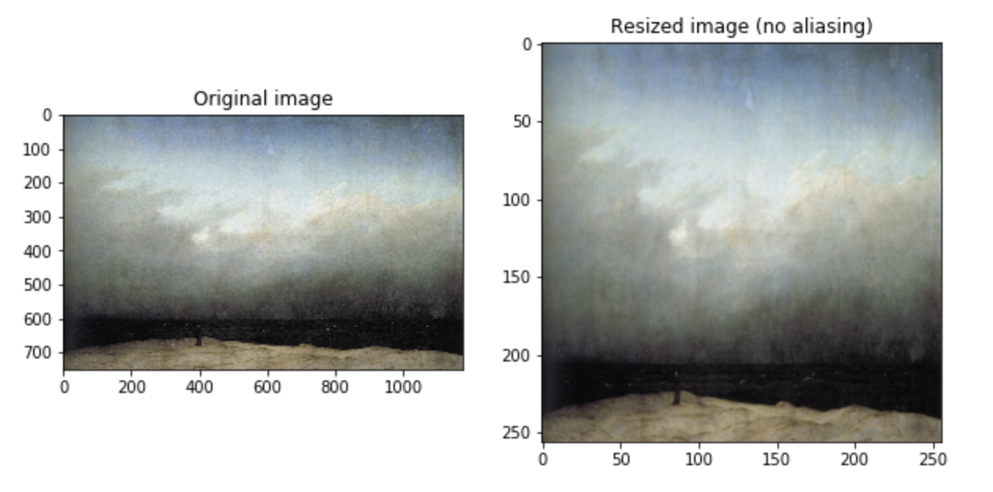
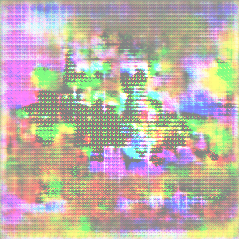
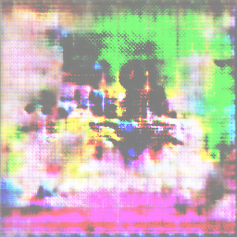
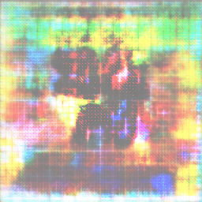
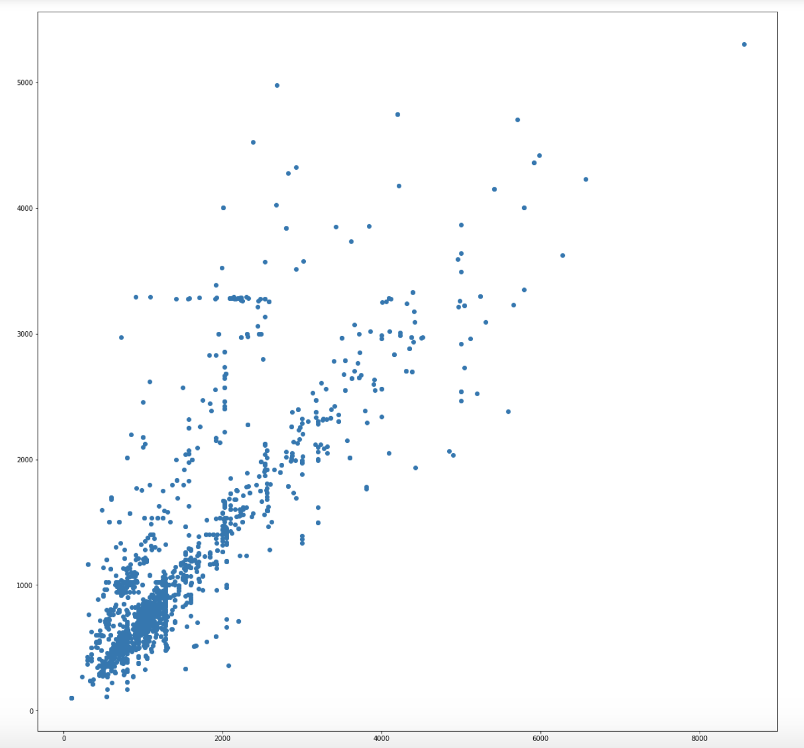
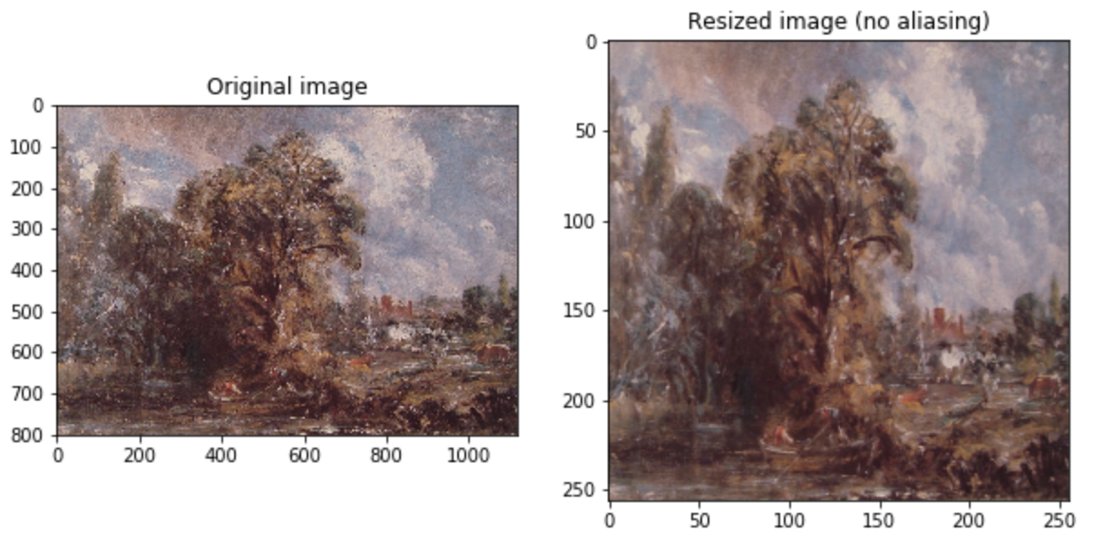
COMP 576 Intro to Deep Learning Final Project - Artificial Art
Jonathan Cai (jmc31), Skylar Xu (yx48)
Rice University, Computer Science Department
Abstract
Results
We attempt to replicate studies that have generated art by using Generative Adversarial Networks (GANs), simulating a given distribution of images. We explore the use of SOTA architectures that utilize transpose convolutional layers and compare them to the results of a simpler model, utilizing only densely connected layers.
Densely connected model results:
At first glance, results from the simplified dense layered model appear to be very abstract paintings. You can barely sense out some simple landscape features –the darker lower portion of the image depicting land, and the lighter upper portion of the image depicting air/sky. The generator does appear to abstract away the smaller detailing of the image distribution, while maintaining the overall, top-bottom structure of the landscape style images.
Convolutional model results:
The results from the complex convolutional layered model don’t really show any distinctive features (even after 125,00+ epochs of training). We can also clearly see patterns in the pixels as produced by the transpose convolutional layers. It appears that the generator is not able to converge in any substantial way, and we suspect that this is due to the discriminator learning significantly faster than the generator, as seen in the plot of the cross-entropy loss over time. This hypothesis is also supported by the fact that our discriminator is more complicated, has far more trainable parameters, as compared to the generator in this model.
Introduction
Recently, there have been many developments in the area of Generative Adversarial Networks. Particularly, GANs have been used to generate creative pieces, including paintings, music, human faces etc.
We want to see if we can replicate these studies, while exploring the usefulness of GANs in art generation, especially with limiting constraints of less budget, resources, and time.
Figure 4. GAN Architecture. We’ve defined the latent space (the random noise) to be R¹⁰⁰ . Also, this diagram depicts the MNIST dataset, but our dataset is much more complicated images of landscapes. It is also worth mentioning that the results of the combined model are back-propagated throughout each model to fit both the discriminator and the generator.
Architecture
Data/Preprocessing
As depicted in the figure above, a typical GAN involves two models, the generator and discriminator. During training, the generator produces fake images, and then the discriminator is fed both fake images and real images from the “ground truth” dataset. The results are then backpropagated through both networks. We ended up using two architectures, one more computationally feasible and using only dense layers (described on the left), and one more computationally expensive, using convolutional and transpose convolutional layers (described on the right).
Hyper-Parameters:
Adam Optimizer w/ 0.0001 learning rate
LeakyReLU w/ 0.2 alpha
Batch size 128
Generator:
Input Noise (100x1)
Dense 256
Leaky ReLU
Batch Norm
Dense 512
Leaky ReLU
Dense 1024
Leaky ReLU
Batch Norm
Dense (256x256x3)
Tanh
Total trainable params: 202,209,536 Discriminator:
Dense 512
Leaky ReLU
Dense 256
Leaky ReLU
Dense 1
Sigmoid
Total trainable params: 100,795,393
Generator : (TC = Transpose Convolutional)
Input Noise (100x1)
TC 4 x 4 x 1024
TC 8 x 8 x 1024
TC 16 x 16 x 512
TC 32 x 32 x 256
TC 64 x 64 x 128
TC 128 x 128 x 64
Image 256 x 256 x 3
Total trainable params:
28,458,505
Discriminator :
Convolutional 32 4 × 4
Leaky ReLU
Convolutional 64 4 × 4
Leaky ReLU
Convolutional 128 4 × 4
Leaky ReLU
Convolutional 256 4 × 4
Leaky ReLU
Convolutional 512 4 × 4
Leaky ReLU
Convolutional 512 4 × 4
Leaky ReLU
Dense 1024
Dense 512
Dense 1
Trainable params: 1,073,909,633
Dataset:
The images used to train our GAN are from WikiArt (Visual Art Encyclopedia).
Preprocessing:
The performed preprocessing was simple. We scaled every image in our dataset into dimensions 256 x 256. We also needed to prune the dataset, removing images that were far too small to be reasonably comprehensible (there was a cluster of 100 x 100 images) and images that were simply not depicting any sort of landscape.
Figure 2. Example image that was manually
removed from the dataset
Conclusions
Through this research, we have learned first-hand the importance of GPU powered computation, and how it enables feasible training wall time for deep learning models.
Also, we learned the hard way, what can happen when one of the two models dominates the other in “competition” during training of the GAN and the other fails to converge as a result.
Figure 1. A few visualizations of the dimension
preprocessing performed on three sample images
taken from our WikiArt dataset.
Figure 3. Distribution of image dimensions in the dataset
Contact
References
Jonathan Cai
Email: jmc31@rice.edu
Skylar Xu
Email: yx48@rice.edu
1. Elgammel et. al., “CAN: Creative Adversarial Networks, Generating "Art" by Learning About Styles and Deviating from Style Norms” arXiv:1706.07068 [cs], Jun. 2017.
2. Goodfellow et. al., “Generative Adversarial Nets” arXiv:1406.2661 [cs], Jun. 2014.
3. B, Nikhil. “Image Data Pre-Processing for Neural Networks.” Medium, Becoming Human: Artificial Intelligence Magazine, 18 Jan. 2019, https://becominghuman.ai/image-data-pre-processing-for-neural-networks-498289068258.
4. Audigier, Benoit. “NoArtist: Generating Art with Artificial Intelligence. Can AI Create a Piece of Art?” Medium, Medium, 8 Mar. 2019, https://medium.com/@benoit.audigier/noartist-generating-art-with-artificial-intelligence-can-ai-create-a-piece-of-art-e87695c6d2b5.
5. Brownlee, Jason. “How to Develop a GAN to Generate CIFAR10 Small Color Photographs.” Machine Learning Mastery, 24 July 2019, https://machinelearningmastery.com/how-to-develop-a-generative-adversarial-network-for-a-cifar-10-small-object-photographs-from-scratch/.

